Slide 1
Python Features
1) Easy to Learn and Use. Python is easy to learn and use. ...
2) Expressive Language. Python language is more expressive means that it is more understandable and readable.
3) Interpreted Language. ...
4) Cross-platform Language. ...
5) Free and Open Source. ...
6) Object-Oriented Language. ...
7) Extensible. ...
8) Large Standard Library.

Slide 2
Character Set in Python
Python uses the traditional ASCII character set. The latest version (2.7) also recognizes the Unicode character set. The ASCII character set is a subset of the Unicode character set.
Tokens
Python breaks each logical line into a sequence of elementary lexical components known as tokens. Each token corresponds to a substring of the logical line. The normal token types are identifiers, keywords, operators, delimiters, and literals

Slide 3
Identifier
An identifier is a name that identifies (that is, labels the identity of) either a unique object or a unique class of objects, where the "object" or class may be an idea, physical [countable] object (or class thereof), or physical [noncountable] substance (or class thereof). An identifier may be a word, number, letter, symbol, or any combination of those.
Python Keywords
Python has a set of keywords that are reserved words that cannot be used as variable names, function names, or any other identifiers:

Slide 4
Examples:
Keyword | Description
and | A logical operator
as | To create an alias
break | To break out of a loop
class | To define a class
continue | To continue to the next iteration of a loop
def | To define a function
del | To delete an object
elif | Used in conditional statements, same as else if
else | Used in conditional statements
for | To create a for loop
from | To import specific parts of a module
if | To make a conditional statement
import | To import a module
in | To check if a value is present in a list, tuple, etc.
is | To test if two variables are equal
None | Represents a null value
not | A logical operator

Slide 5
Literals
A literal is a number or string that appears directly in a program. The following are all literals in Python:
42 Integer literal
3.14 Floating-point literal
1.0j Imaginary literal
'hello’ String literal
"world" Another string literal
"""Good night""" Triple-quoted string literal

Slide 6
Delimiters
Python uses the following symbols and symbol combinations as delimiters in expressions, lists, dictionaries, various aspects of statements, and strings, among other purposes:
( | ) | [ | ] | { | }
, | : | . | ` | = | ;
+= | -= | *= | /= | //= | %=
&= | |= | ^= | >>= | <<= | **=

Slide 7
Operator
Python language supports the following types of operators.
Arithmetic Operators
Comparison (Relational) Operators
Assignment Operators
Logical Operators
Membership Operators
Identity Operators

Slide 8
Python Variables, Constants
Python Variables
A variable is a named location used to store data in the memory. It is helpful to think of variables as a container that holds data that can be changed later in the program. For example,
number = 10
Example : Declaring and assigning value to a variable
website = "apple.com"
print(website)

Slide 9
Rules of Variable name
Variable names can range from 1 to 255 characters. To make variable names portable to other environments stay within a 1 to 31 character range.
All variable names must begin with a letter of the alphabet or an underscore( _ ). For beginning programmers, it may be easier to begin all variable names with a letter of the alphabet.
After the first initial letter, variable names can also contain letters and numbers. No spaces or special characters, however, are allowed.
You cannot use a keyword (reserved word) as a variable name.

Slide 10
Left and right values.
A left value or l-value is an assignable object. It is any expression that may occur on the left side of an assignment. Variables are obvious l-values, but so are items in lists.
(b) A right value or r-value is any expression that has a value that may appear on the right of an assignment. In python, everything is an r-value.

Slide 11
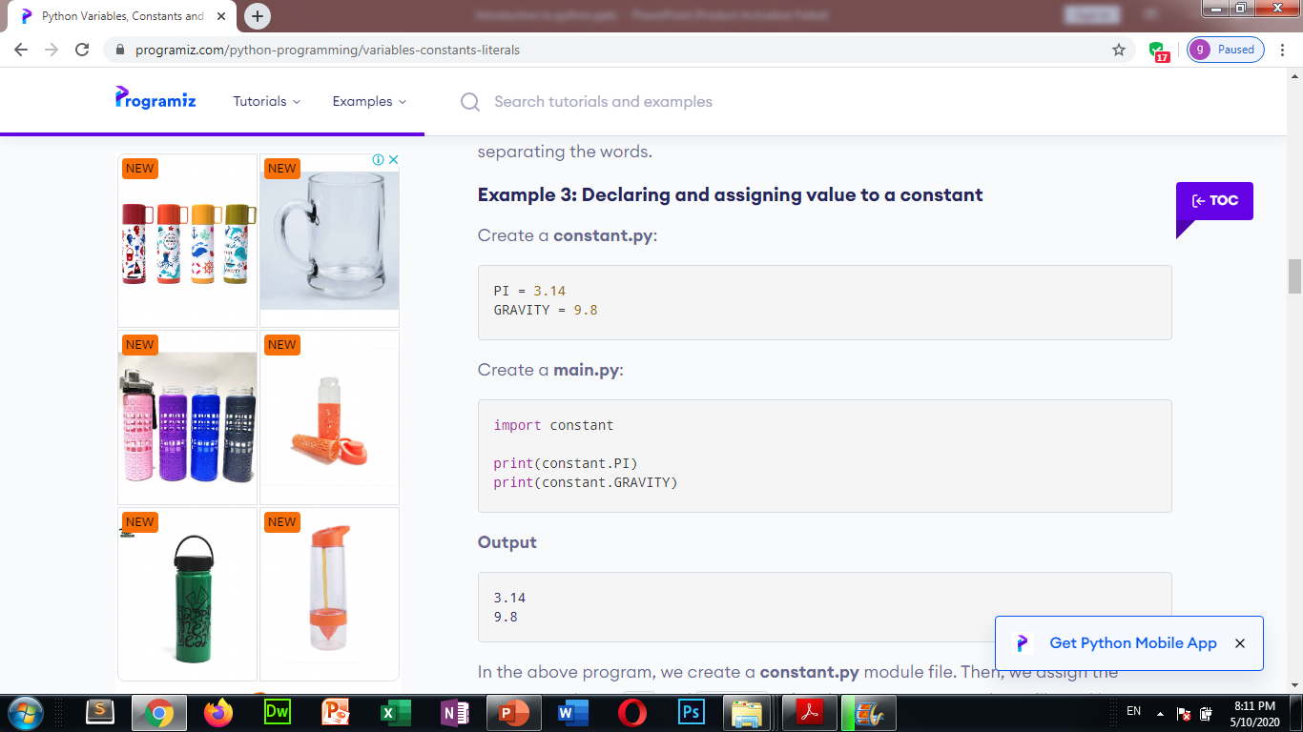
Constants
A constant is a type of variable whose value cannot be changed. It is helpful to think of constants as containers that hold information which cannot be changed later.

Slide 12
Comments in Python
When working with any programming language, you include comments in the code to notate your work. This details what certain parts of the code are for, and lets other developers – you included – know what you were up to when you wrote the code. This is a necessary practice, and good developers make heavy use of the comment system. Without it, things can get real confusing, real fast.
Single-line comments are created simply by beginning a line with the hash (#) character, and they are automatically terminated by the end of line.
For example:
Single-line comments are created simply by beginning a line with the hash (#) character, and they are automatically terminated by the end of line.
For example:
#This would be a comment in Python
Comments multiple lines – used to explain things in more detail – are created by adding a delimiter (""") on each end of the comment.
""" This would be a multiline comment in Python that spans several lines and describes your code, your day, or anything you want it to """

Slide 13
statements in python
Instructions that a Python interpreter can execute are called statements. For example, a = 1 is an assignment statement. if statement, for statement, while statement, etc.

Slide 14
Python Expressions:
Expressions are representations of value. They are different from statement in the fact that statements do something while expressions are representation of value. For example any string is also an expressions since it represents the value of the string as well.
Example
[x for x in range(10)]
true_value if Condition else false_value
Input / Output statement:
A=input(‘Enter your name’)
Print(a)

Slide 15
Python data types
Integers
In Python 3, there is effectively no limit to how long an integer value can be. Of course, it is constrained by the amount of memory your system has, as are all things, but beyond that an integer can be as long as you need it to be:
>>>>>>
(123123123123123123123123123123123123123123123123 + 1) 123123123123123123123123123123123123123123123124
Floating-Point Numbers
The float type in Python designates a floating-point number. float values are specified with a decimal point.
>>>>>> 4.2 4.2 >>>
(4.2) <class 'float'>
Strings
Strings are sequences of character data. The string type in Python is called str.
String literals may be delimited using either single or double quotes. All the characters between the opening delimiter and matching closing delimiter are part of the string:
>>>>>>
("I am a string.") I am a string. >>>
("I am a string.") <class 'str'>

Slide 16
Mutable and immutable data type
Simple put, a mutable object can be changed after it is created, and an immutable object can't. Objects of built-in types like (int, float, bool, str, tuple, unicode) are immutable. Objects of built-in types like (list, set, dict) are mutable. Custom classes are generally mutable.

Slide 17
Python Operators Precedence
The following table lists all operators from highest precedence to lowest.
Sr.No. | Operator & Description
1 | ** Exponentiation (raise to the power)
2 | ~ + - Complement, unary plus and minus (method names for the last two are +@ and -@)
3 | * / % // Multiply, divide, modulo and floor division
4 | + - Addition and subtraction
5 | >> << Right and left bitwise shift
6 | & Bitwise 'AND'
7 | ^ | Bitwise exclusive `OR' and regular `OR'
8 | <= < > >= Comparison operators
9 | <> == != Equality operators
10 | = %= /= //= -= += *= **= Assignment operators
11 | is is not Identity operators
12 | in not in Membership operators
13 | not or and Logical operators

Slide 18
Types of Operator
Python language supports the following types of operators.
Arithmetic Operators
Comparison (Relational) Operators
Assignment Operators
Logical Operators
Membership Operators
Identity Operators

Slide 19
Python Arithmetic Operators
Assume variable a holds 10 and variable b holds 20, then −
Operator | Description | Example
+ Addition | Adds values on either side of the operator. | a + b = 30
- Subtraction | Subtracts right hand operand from left hand operand. | a – b = -10
* Multiplication | Multiplies values on either side of the operator | a * b = 200
/ Division | Divides left hand operand by right hand operand | b / a = 2
% Modulus | Divides left hand operand by right hand operand and returns remainder | b % a = 0
** Exponent | Performs exponential (power) calculation on operators | a**b =10 to the power 20
// | Floor Division - The division of operands where the result is the quotient in which the digits after the decimal point are removed. But if one of the operands is negative, the result is floored, i.e., rounded away from zero (towards negative infinity) − | 9//2 = 4 and 9.0//2.0 = 4.0, -11//3 = -4, -11.0//3 = -4.0

Slide 20
Python Comparison(Relational) Operators
Assume variable a holds 10 and variable b holds 20, then −
Operator | Description | Example
== | If the values of two operands are equal, then the condition becomes true. | (a == b) is not true.
!= | If values of two operands are not equal, then condition becomes true. | (a != b) is true.
<> | If values of two operands are not equal, then condition becomes true. | (a <> b) is true. This is similar to != operator.
> | If the value of left operand is greater than the value of right operand, then condition becomes true. | (a > b) is not true.
< | If the value of left operand is less than the value of right operand, then condition becomes true. | (a < b) is true.
>= | If the value of left operand is greater than or equal to the value of right operand, then condition becomes true. | (a >= b) is not true.
<= | If the value of left operand is less than or equal to the value of right operand, then condition becomes true. | (a <= b) is true.

Slide 21
Python Assignment Operators
Operator | Description | Example
= | Assigns values from right side operands to left side operand | c = a + b assigns value of a + b into c
+= Add AND | It adds right operand to the left operand and assign the result to left operand | c += a is equivalent to c = c + a
-= Subtract AND | It subtracts right operand from the left operand and assign the result to left operand | c -= a is equivalent to c = c - a
*= Multiply AND | It multiplies right operand with the left operand and assign the result to left operand | c *= a is equivalent to c = c * a
/= Divide AND | It divides left operand with the right operand and assign the result to left operand | c /= a is equivalent to c = c / a
%= Modulus AND | It takes modulus using two operands and assign the result to left operand | c %= a is equivalent to c = c % a
**= Exponent AND | Performs exponential (power) calculation on operators and assign value to the left operand | c **= a is equivalent to c = c ** a
//= Floor Division | It performs floor division on operators and assign value to the left operand | c //= a is equivalent to c = c // a

Slide 22
Python Logical Operators
Assume variable a holds 10 and variable b holds 20, then −
Operator | Description | Example
and Logical AND | If both the operands are true then condition becomes true. | (a and b) is true.
or Logical OR | If any of the two operands are non-zero then condition becomes true. | (a or b) is true.
not Logical NOT | Used to reverse the logical state of its operand. | Not(a and b) is false.

Slide 23
Python Membership Operators
Python’s membership operators test for membership in a sequence, such as strings, lists, or tuples.
Operator | Description | Example
in | Evaluates to true if it finds a variable in the specified sequence and false otherwise. | x in y, here in results in a 1 if x is a member of sequence y.
not in | Evaluates to true if it does not finds a variable in the specified sequence and false otherwise. | x not in y, here not in results in a 1 if x is not a member of sequence y.

Slide 24
Python Identity Operators
Identity operators compare the memory locations of two objects.
Operator | Description | Example
is | Evaluates to true if the variables on either side of the operator point to the same object and false otherwise. | x is y, here is results in 1 if id(x) equals id(y).
is not | Evaluates to false if the variables on either side of the operator point to the same object and true otherwise. | x is not y, here is not results in 1 if id(x) is not equal to id(y).

Slide 25
Type Conversion in Python
Python defines type conversion functions to directly convert one data type to another which is useful in day to day and competitive programming. This article is aimed at providing the information about certain conversion functions.
1. int(a,base) : This function converts any data type to integer. ‘Base’ specifies the base in which string is if data type is string.
2. float() : This function is used to convert any data type to a floating point number
3. ord() : This function is used to convert a character to integer.
4. hex() : This function is to convert integer to hexadecimal string.
5. oct() : This function is to convert integer to octal string.
6. tuple() : This function is used to convert to a tuple.
7. set() : This function returns the type after converting to set.
8. list() : This function is used to convert any data type to a list type.
9. dict() : This function is used to convert a tuple of order (key,value) into a dictionary.
10. str() : Used to convert integer into a string.
11. complex(real,imag) : : This function converts real numbers to complex(real,imag) number.
filter_none
12. chr(number) : : This function converts number to its corresponding ASCII character.

Slide 26
Execution of a python program
The Python interpreter performs following tasks to execute a Python program :
Step 1 : The interpreter reads a python code or instruction. Then it verifies that the instruction is well formatted, i.e. it checks the syntax of each line.If it encounters any error, it immediately halts the translation and shows an error message.
Step 2 : If there is no error, i.e. if the python instruction or code is well formatted then the interpreter translates it into its equivalent form in intermediate language called “Byte code”.Thus, after successful execution of Python script or code, it is completely translated into Byte code.
Step 3 : Byte code is sent to the Python Virtual Machine(PVM).Here again the byte code is executed on PVM.If an error occurs during this execution then the execution is halted with an error message.

Slide 27
Errors
Errors or mistakes in a program are often referred to as bugs. They are almost always the fault of the programmer. The process of finding and eliminating errors is called debugging. Errors can be classified into three major groups:
Syntax errors
Runtime errors
Logical errors

Slide 28
Syntax errors
Python will find these kinds of errors when it tries to parse your program, and exit with an error message without running anything. Syntax errors are mistakes in the use of the Python language.
Common Python syntax errors include:
leaving out a keyword
putting a keyword in the wrong place
leaving out a symbol, such as a colon, comma or brackets
misspelling a keyword
incorrect indentation
empty block
>>> print "hello" SyntaxError: Missing parentheses in call to 'print'. Did you mean print("hello")?

Slide 29
Runtime errors
If a program is syntactically correct – that is, free of syntax errors – it will be run by the Python interpreter. However, the program may exit unexpectedly during execution if it encounters a runtime error – a problem which was not detected when the program was parsed, but is only revealed when a particular line is executed. When a program comes to a halt because of a runtime error, we say that it has crashed.
Some examples of Python runtime errors:
division by zero
performing an operation on incompatible types
using an identifier which has not been defined
accessing a list element, dictionary value or object attribute which doesn’t exist
trying to access a file which doesn’t exist

Slide 30
Logical errors
Logical errors are the most difficult to fix. They occur when the program runs without crashing, but produces an incorrect result. The error is caused by a mistake in the program’s logic. You won’t get an error message, because no syntax or runtime error has occurred. You will have to find the problem on your own by reviewing all the relevant parts of your code
using the wrong variable name
indenting a block to the wrong level
using integer division instead of floating-point division
getting operator precedence wrong
making a mistake in a boolean expression
off-by-one, and other numerical errors

Slide 31
Thanks

